Slide 1
UEZ Technical Consultancy Project
Delight Supported living Ltd

Slide 2
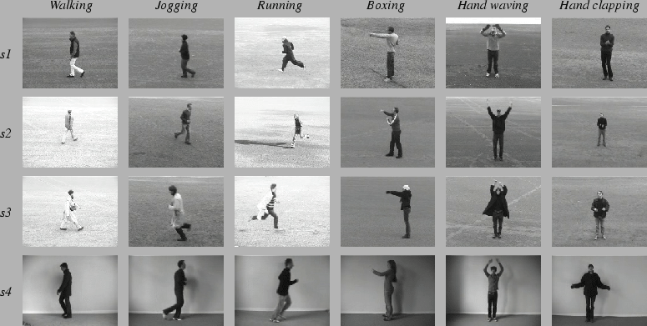
Dataset – KTH dataset
The current video database containing six types of human actions (walking, jogging, running, boxing, hand waving and hand clapping) performed several times by 25 subjects(humans) in four different scenarios:
outdoors s1,
outdoors with scale variation s2,
outdoors with different clothes s3,
Indoors s4 as illustrated below.
Currently the database contains 2391 sequences. All sequences were taken over homogeneous backgrounds with a static camera with 25fps frame rate.
The sequences were down sampled to the spatial resolution of 160x120 pixels and have a length of four seconds in average.

Slide 3
Dataset
In our experiments all sequences were divided with respect to the subjects into a training set (8 persons), a validation set (8 persons) and a test set (9 persons).
The classifiers were trained on a training set while the validation set was used to optimize the parameters of each method. The recognition results were obtained on the test set.
To reduce the computation complexity and memory requirement, the original input frames 160×120 are reduced to 120×120 resolutions in our experiments.
Steps:
Load Data
Preprocess the data(dividing the data into training, validation and test set)
Create the model(3D CNN)
Train the model
Validate the model
Test the model

Slide 4
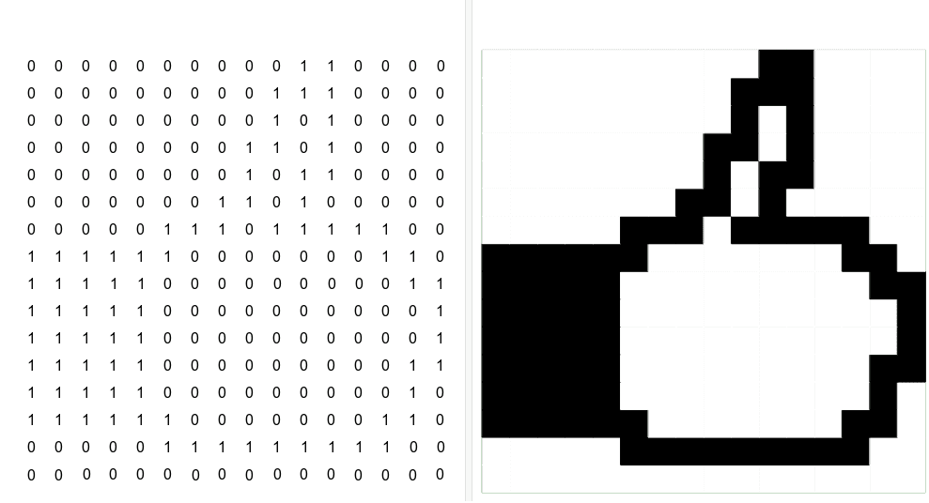
Model - 3D CONVOLUTIONAL NEURAL NETWORKS
2d Image Pixels

Slide 5
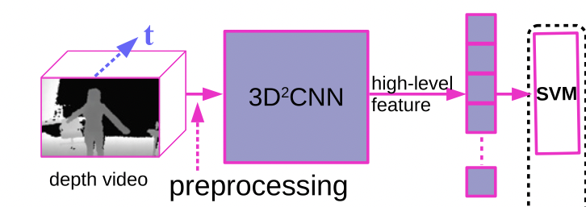
Model

Slide 6
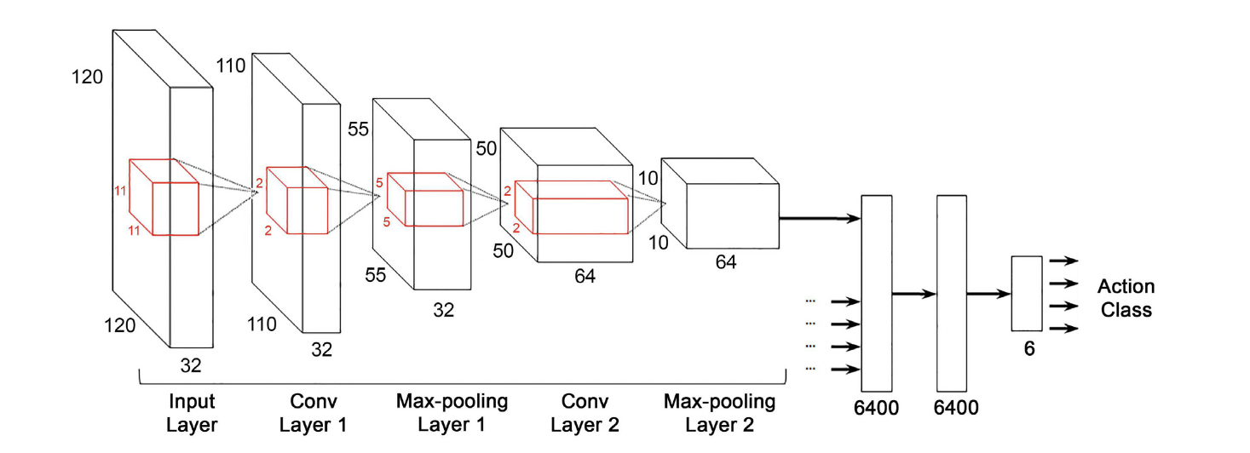
CNN architecture

Slide 7
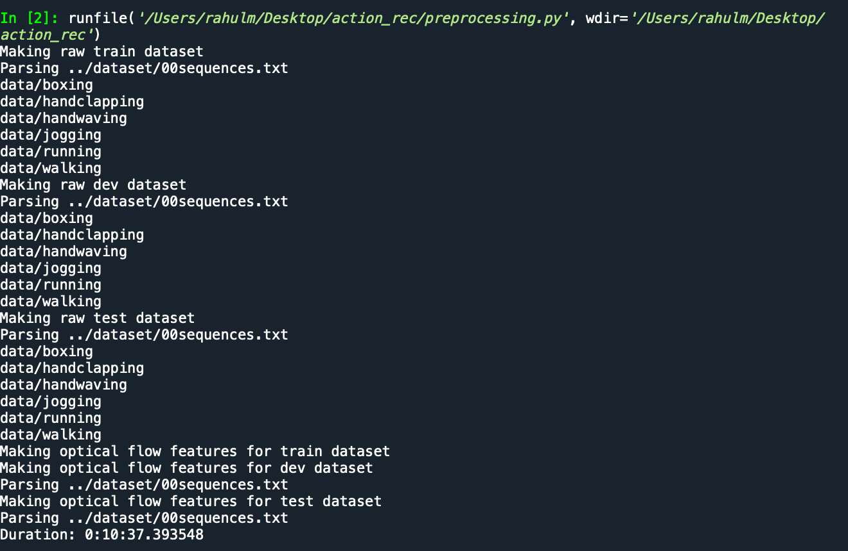
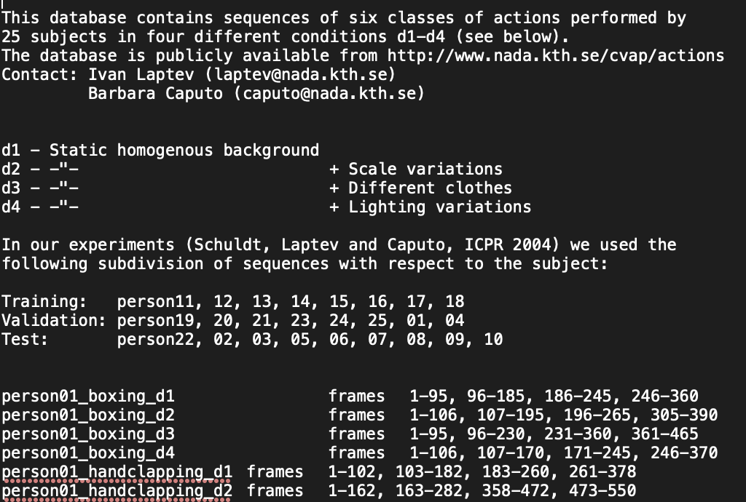
Data preprocessing
Making raw datasets for training, validation and testing by parsing 00sequence.txt file.
00sequence.txt
Output:

Slide 8
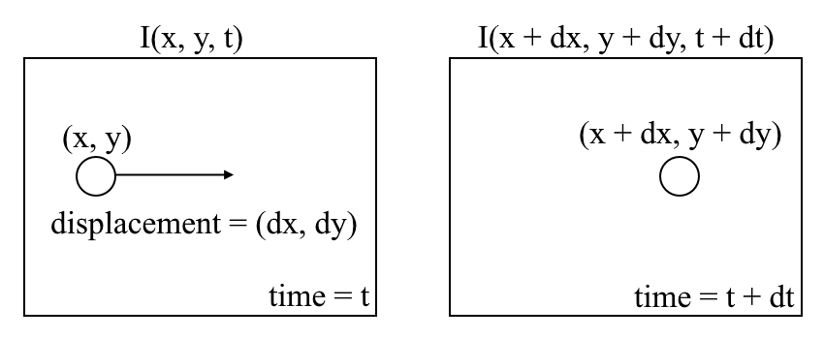
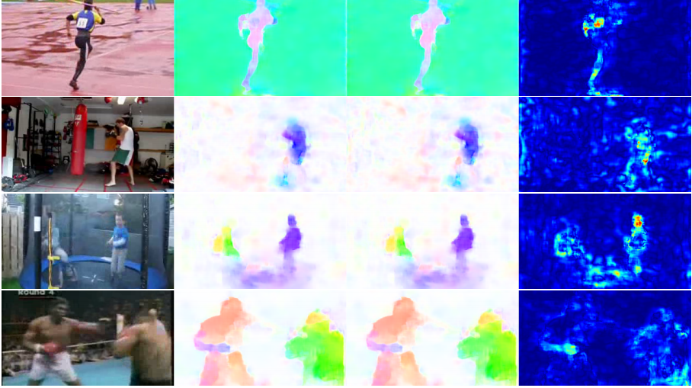
Optical flow
Optical flow is the motion of objects between consecutive frames of sequence, caused by the relative movement between the object and camera.
the first image I(x,y,t) and move its pixels by (dx,dy) over t time, we obtain the new image I(x+dx,y+dy,t+dt).
Fig: Human action recognition using optical flow

Slide 9
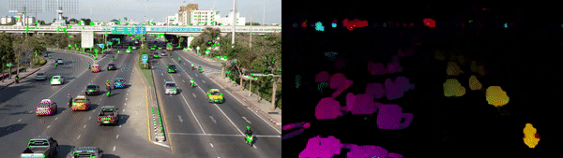
Optical flow
Sparse optical flow
Dense optical flow
Sparse optical flow gives the flow vectors of some "interesting features" (say few pixels depicting the edges or corners of an object) within the frame
Dense Optical flow computes the optical flow vector for every pixel of the frame which may be responsible for its slow speed but leading to a better accurate result.
Left: Sparse Optical Flow – track few “features” pixels
Right: Dense Optical Flow – Estimate flow of all pixels in the image

Slide 10
Video Classification
3 Methods
2D CNN
3D CNN
3D CNN with Optical flow

Slide 11
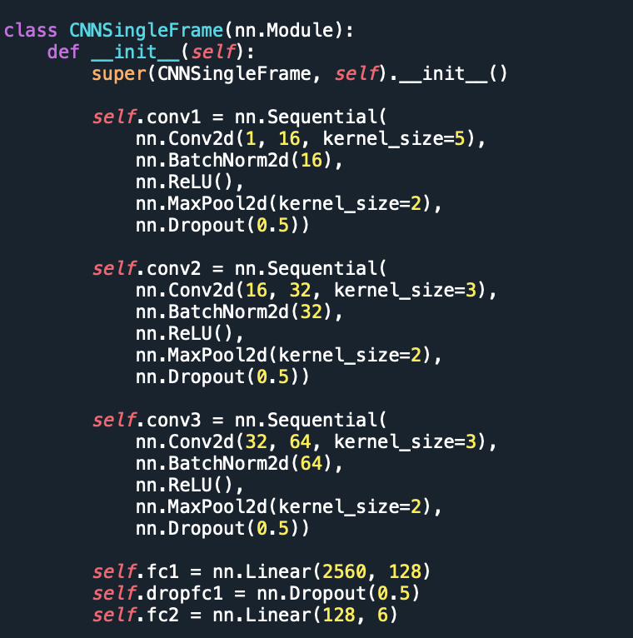
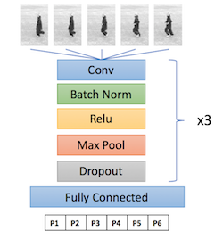
2D-CNN Model
This model is trained by sending individual frames as input.
in_channels (int) – Number of channels in the input image
out_channels (int) – Number of channels produced by the convolution
kernel_size (int or tuple) – Size of the convolving kernel
Dropout - Dropout is a
Technique, where randomly selected neurons are ignored during training.
They are “dropped-out” randomly.
Batch size : No of training examples for each iteration.

Slide 12
Procedure for sending raw data to CNN
In the first stage of pre-processing, we extracted and sorted the video data according to 00sequence.txt instruction file.
Then the pre-processed data is stored in ‘train.p’, ‘dev.p(validation data)’ and ‘train.p’. (Which are python pickle binary files) and these data sets consists of binary format of each fame of video and the video categories.
The ‘read_dataset()’ from ‘﻿class RawDataset(Dataset)’returns the instances(video-frame binary data) and their categories to train.py
﻿for video in videos:
for frame in video["frames"]:
instances.append(frame.reshape((1, 60, 80)))
labels.append(CATEGORY_INDEX[video["category"]])

Slide 13
Epoch-Checkpoints
﻿run train_cnn.py --batch_size=64 --start_epoch=1 --num_epochs=23 --cuda=0
epoch 9/13, train_loss = tensor(0.4881), traic_acc = tensor(0.7687), dev_loss = tensor(1.4009), dev_acc = tensor(0.5634)
﻿epoch 10/13, train_loss = tensor(0.4792), traic_acc = tensor(0.7766), dev_loss = tensor(1.2668), dev_acc = tensor(0.5767)
﻿epoch 11/13, train_loss = tensor(0.4504), traic_acc = tensor(0.7808), dev_loss = tensor(1.4432), dev_acc = tensor(0.5713)
﻿epoch 12/13, train_loss = tensor(0.4445), traic_acc = tensor(0.7877), dev_loss = tensor(1.5296), dev_acc = tensor(0.5724)
﻿epoch 13/13, train_loss = tensor(0.4330), traic_acc = tensor(0.8027), dev_loss = tensor(1.2743), dev_acc = tensor(0.5957)
﻿epoch 17/23, train_loss = tensor(0.3848), traic_acc = tensor(0.8243), dev_loss = tensor(1.2812), dev_acc = tensor(0.6065)
﻿epoch 18/23, train_loss = tensor(0.3961), traic_acc = tensor(0.8272), dev_loss = tensor(1.3042), dev_acc = tensor(0.6016)
﻿epoch 19/23, train_loss = tensor(0.3707), traic_acc = tensor(0.8377), dev_loss = tensor(1.2247), dev_acc = tensor(0.6101)
﻿epoch 20/23, train_loss = tensor(0.3631), traic_acc = tensor(0.8344), dev_loss = tensor(1.4471), dev_acc = tensor(0.6141)
﻿epoch 21/23, train_loss = tensor(0.3557), traic_acc = tensor(0.8469), dev_loss = tensor(1.3003), dev_acc = tensor(0.6184)
﻿epoch 22/23, train_loss = tensor(0.3550), traic_acc = tensor(0.8425), dev_loss = tensor(1.1377), dev_acc = tensor(0.6244)
﻿epoch 23/23, train_loss = tensor(0.3412), traic_acc = tensor(0.8460), dev_loss = tensor(1.1549), dev_acc = tensor(0.6294)

Slide 14
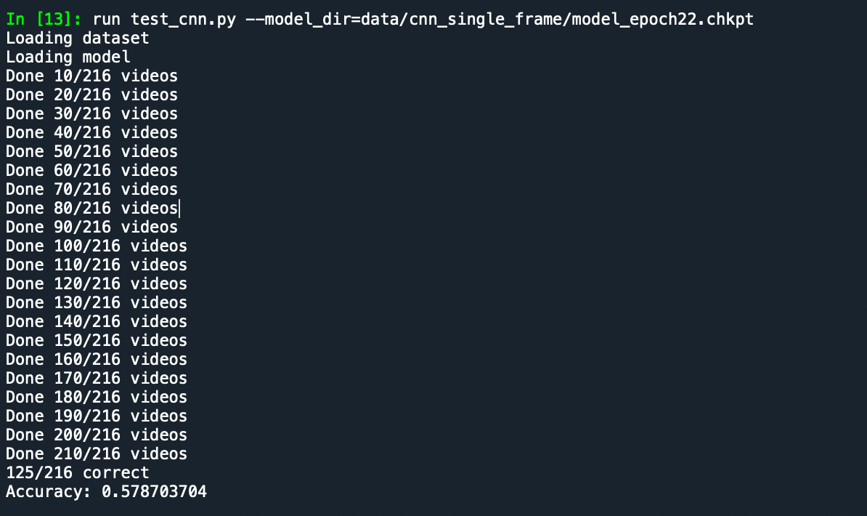
Testing
Now test the model by passing the test data set to the model and predict the actions from the videos and then compare those predicted results with the actual category(ex: walking,running…).
The data can be tested at different levels of models generated at each epoch as checkoints.

Slide 15
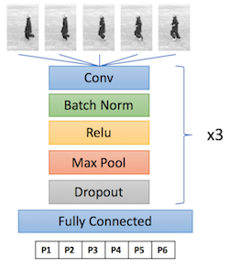
3D CNN
For each video, we divide it into blocks of ‘n’ contiguous frames. The model is then trained on these blocks instead of individual frame. In the convolutional layers, we use 3D convolutional filters to train the model to learn to detect temporal features.
Implementation – Need to be done (next week)

Slide 16
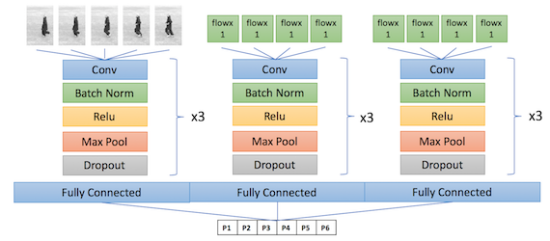
3D CNN with Optical flow
This model is same as 3D CNN, but additionally the model need to be trained on optical flow features.
Implementation : Need to be done(Next week)

